Slide 1




Pseudorandom Numbers
Randomly chosen numbers are needed for many purposes,
including computer simulations.
Pseudorandom numbers are not truly random since they are generated by systematic methods.
The linear congruential method is one commonly used procedure
for generating pseudorandom numbers.
Four integers are needed: the modulus m, the multiplier a, the
increment c, and seed x₀, with 2 ≤ a < m, 0 ≤ c < m, 0 ≤ x₀ < m.
We generate a sequence of pseudorandom numbers {x_{n}}, with
0 ≤ x_{n} < m for all n, by successively using the recursively defined function
^{x}n+1
= (ax + c) mod m.
n
(an example of a recursive definition, discussed in Section 5.3)
If psudorandom numbers between 0 and 1 are needed, then the generated numbers are divided by the modulus, x_{n} /m.

Slide 2

Pseudorandom Numbers
Example: Find the sequence of pseudorandom numbers generated by the linear congruential method with modulus m = 9, multiplier a = 7, increment c = 4, and seed x₀ = 3.
Solution: Compute the terms of the sequence by successively using the congruence = (7x_{n} + 4) mod 9, with x₀ = 3.
^{x}n+1
x₁ = 7x₀ + 4 mod 9 = 7∙3 + 4 mod 9 = 25 mod 9 = 7,
x₂ = 7x₁ + 4 mod 9 = 7∙7 + 4 mod 9 = 53 mod 9 = 8,
x₃ = 7x₂ + 4 mod 9 = 7∙8 + 4 mod 9 = 60 mod 9 = 6,
x₄ = 7x₃ + 4 mod 9 = 7∙6 + 4 mod 9 = 46 mod 9 = 1,
x₅ = 7x₄ + 4 mod 9 = 7∙1 + 4 mod 9 = 11 mod 9 = 2,
x₆ = 7x₅ + 4 mod 9 = 7∙2 + 4 mod 9 = 18 mod 9 = 0,
x₇ = 7x₆ + 4 mod 9 = 7∙0 + 4 mod 9 = 4 mod 9 = 4,
x₈ = 7x₇ + 4 mod 9 = 7∙4 + 4 mod 9 = 32 mod 9 = 5,
x₉ = 7x₈ + 4 mod 9 = 7∙5 + 4 mod 9 = 39 mod 9 = 3.
The sequence generated is 3,7,8,6,1,2,0,4,5,3,7,8,6,1,2,0,4,5,3,…
It repeats after generating 9 terms.
Commonly, computers use a linear congruential generator with increment c = 0. This is called a pure multiplicative generator. Such a generator with modulus 2³¹ − 1 and multiplier 7⁵ = 16,807 generates 2³¹ − 2 numbers before repeating.

Slide 3

Check Digits: UPCs
A common method of detecting errors in strings of digits is to add an extra digit at the end, which is evaluated using a function. If the final digit is not correct, then the string is assumed not to be correct.
Example: Retail products are identified by their Universal Product Codes (UPCs). Usually these have 12 decimal digits, the last one being the check digit. The check digit is determined by the congruence:
3x₁ + x₂ + 3x₃ + x₄ + 3x₅ + x₆ + 3x₇ + x₈ + 3x₉ + x₁₀ + 3x₁₁ + x₁₂ ≡ 0 (mod 10).
Suppose that the first 11 digits of the UPC are 79357343104. What is the check
digit?
Is 041331021641 a valid UPC? Solution:
a. + + + + + +
a. 3∙7 + 9 + 3∙3 + 5 + 3∙7 + 3 + 3∙4 + 3 + 3∙1 + 0 + 3∙4 + x₁₂ ≡ 0 (mod 10)
21 + 9 + 9 + 5 + 21 + 3 + 12+ 3 + 3 + 0 + 12 + x₁₂ ≡ 0 (mod 10)
98 + x₁₂ ≡ 0 (mod 10)
x₁₂ ≡ 0 (mod 10) So, the check digit is 2.
b. 3∙0 + 4 + 3∙1 + 3 + 3∙3 + 1 + 3∙0 + 2 + 3∙1 + 6 + 3∙4 + 1 ≡ 0 (mod 10)
0 + 4 + 3 + 3 + 9 + 1 + 0+ 2 + 3 + 6 + 12 + 1 = 44 ≡ 4 ≢ (mod 10)
Hence, 041331021641 is not a valid UPC.
3.7
9
3.3
5
3.7
3
3.4

Slide 4

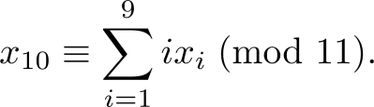

Check Digits:ISBNs
Books are identified by an International Standard Book Number (ISBN-10), a 10 digit code. The first 9 digits identify the language, the publisher, and the book. The tenth digit is a check digit, which is determined by the following congruence
The validity of an ISBN-10 number can be evaluated with the equivalent
a.
b.
Suppose that the first 9 digits of the ISBN-10 are 007288008. What is the check digit? Is 084930149X a valid ISBN10?
Solution:
a. X₁₀ ≡ 1∙0 + 2∙0 + 3∙7 + 4∙2 + 5∙8 + 6∙8 + 7∙ 0 + 8∙0 + 9∙8 (mod 11).
X is used for the digit 10.
X₁₀ ≡ 0 + 0 + 21 + 8 + 40 + 48 + 0 + 0 + 72 (mod 11).
X₁₀ ≡ 189 ≡ 2 (mod 11). Hence, X₁₀ = 2.
b.
1∙0 + 2∙8 + 3∙4 + 4∙9 + 5∙3 + 6∙0 + 7∙ 1 + 8∙4 + 9∙9 + 10∙10 =
0 + 16 + 12 + 36 + 15 + 0 + 7 + 32 + 81 + 100 = 299 ≡ 2 ≢ 0 (mod 11)
Hence, 084930149X is not a valid ISBN-10.
A single error is an error in one digit of an identification number and a transposition error is the accidental interchanging of two digits. Both of these kinds of errors can be detected by the check digit for ISBN-10. (see text for more details)

Slide 5

Arithmetic Modulo m
Definitions: Let Z_{m} be the set of nonnegative integers less than m: {0,1, …., m−1}
The operation +_{m} is defined as a +_{m} b = (a + b) mod m.
This is addition modulo m.
The operation ∙_{m} is defined as a ∙_{m} b = (a . b) mod m. This is multiplication modulo m.
Using these operations is said to be doing arithmetic
modulo m.
Example: Find 7 +₁₁ 9 and 7 ∙₁₁ 9.
Solution: Using the definitions above:
7 +₁₁ 9 = (7 + 9) mod 11 = 16 mod 11 = 5
7 ∙₁₁ 9 = (7 ∙ 9) mod 11 = 63 mod 11 = 8

Slide 6

Arithmetic Modulo m
The operations +_{m} and ∙_{m} satisfy many of the same properties as ordinary addition and multiplication.
Closure: If a and b belong to Z_{m} , then a +_{m} b and a ∙_{m} b belong to Z_{m} .
Associativity: If a, b, and c belong to Z_{m} , then
(a +_{m} b) +_{m} c = a +_{m} (b +_{m} c) and (a ∙_{m} b) ∙_{m} c = a ∙_{m} (b ∙_{m} c).
Commutativity: If a and b belong to Z_{m} , then
a +_{m} b = b +_{m} a and a ∙_{m} b = b ∙_{m} a.
Identity elements: The elements 0 and 1 are identity elements for addition and multiplication modulo m, respectively.
If a belongs to Z_{m} , then a +_{m} 0 = a and a ∙_{m} 1 = a.
continued →

Slide 7

Arithmetic Modulo m
Additive inverses: If a≠ 0 belongs to Z_{m} , then m− a is the additive inverse of a modulo m and 0 is its own additive inverse.
a +_{m} (m− a ) = 0 and 0 +_{m} 0 = 0
Lets suppose a= 2 and m =12, (2+12-2)mod 12 = 0,
Lets suppose a =15 and m =12, (15+12-15)mod 12 = 0
Distributivity: If a, b, and c belong to Z_{m} , then
a ∙_{m} (b +_{m} c) = (a ∙_{m} b) +_{m} (a ∙_{m} c) and
(a +_{m} b) ∙_{m} c = (a ∙_{m} c) +_{m} (b ∙_{m} c).
Exercises 42-44 ask for proofs of these properties.
Multiplicatative inverses have not been included since they do not always exist. For example, there is no multiplicative inverse of 2 modulo 6.
(optional) Using the terminology of abstract algebra, Z_{m} with +_{m} is a commutative group and Z_{m} with +_{m} and ∙_{m} is a commutative ring.

Slide 8



Section 4.3

Slide 9

Section Summary
Prime Numbers and their Properties
Greatest Common Divisors and Least Common Multiples
The Euclidian Algorithm
gcds as Linear Combinations

Slide 10

Primes
Definition: A positive integer p greater than 1 is called prime if the only positive factors of p are 1 and
p. A positive integer that is greater than 1 and is not prime is called composite.
Example: The integer 7 is prime because its only positive factors are 1 and 7, but 9 is composite because it is divisible by 3.

Slide 11

The Fundamental Theorem of Arithmetic
Theorem: Every positive integer greater than 1 can be written uniquely as a prime or as the product of two or more primes where the prime factors are written in order of non decreasing size.
Examples:
100 = 2 ∙ 2 ∙ 5 ∙ 5 = 2² ∙ 5²
641 = 641
999 = 3 ∙ 3 ∙ 3 ∙ 37 = 3³ ∙ 37
1024 = 2 ∙ 2 ∙ 2 ∙ 2 ∙ 2 ∙ 2 ∙ 2 ∙ 2 ∙ 2 ∙ 2 = 2¹⁰

Slide 12

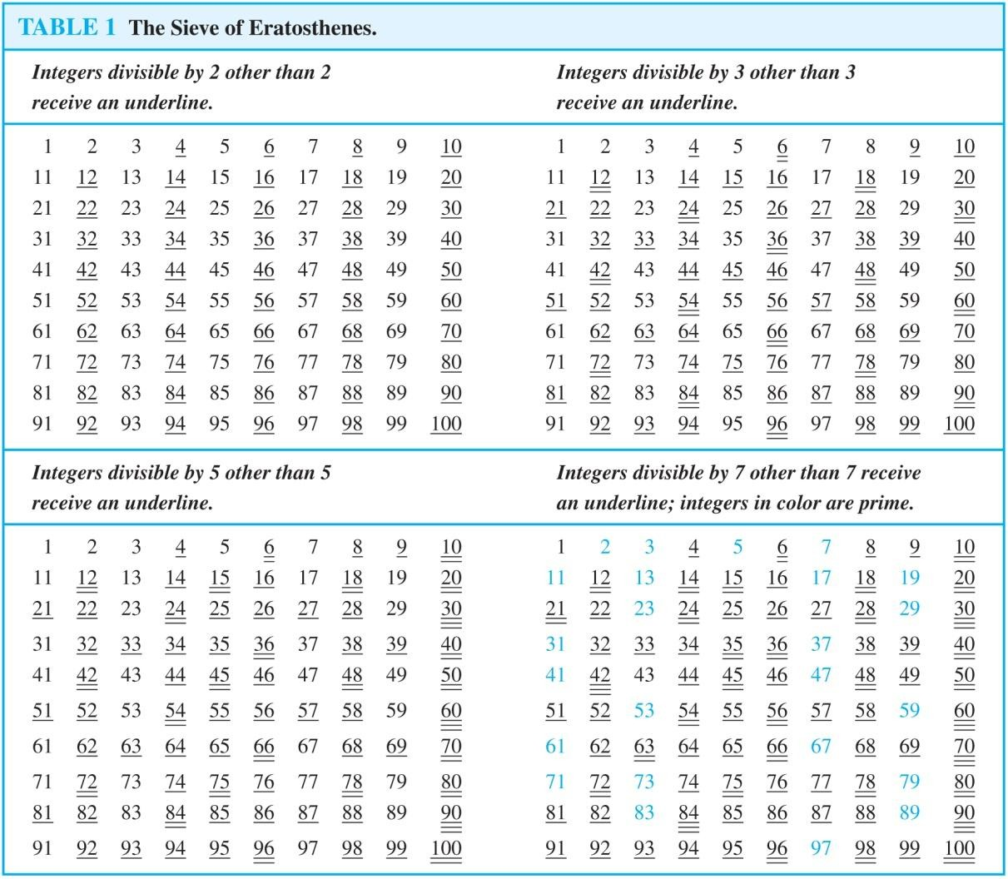
The Sieve of Erastosthenes
If an integer n is a composite integer, then it has a prime divisor less than or equal to √n.
To see this, note that if n = ab, then a ≤ √n or b ≤√n.
Trial division, a very inefficient method of determining if a number n is prime, is to try every integer i ≤√n and see if n is divisible by i.

Slide 13

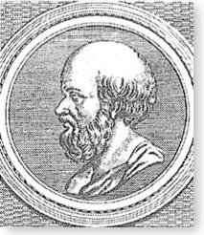
The Sieve of Erastosthenes
Erastothenes (276-194 B.C.)
The Sieve of Erastosthenes can be used to find all primes not exceeding a specified positive integer. For example, begin with the list of integers between 1 and 100.
Delete all the integers, other than 2, divisible by 2.
Delete all the integers, other than 3, divisible by 3.
Next, delete all the integers, other than 5, divisible by 5.
Next, delete all the integers, other than 7, divisible by 7.
Since all the remaining integers are not divisible by any of
the previous integers, other than 1, the primes are:
{2,3,5,7,11,13,17,19,23,29,31,37,41,43,47,53,59,61,67,71,73,79,83,89,
97}
continued →

Slide 14
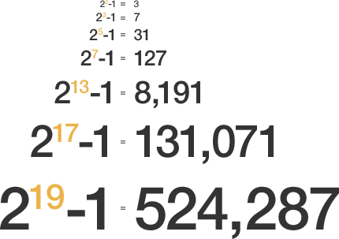
Mersenne Primes

